Slide 1
Capstone Project 1 Hotel Booking Analysis By Shasank Chawla

Slide 2
DATA SET OF HOTEL BOOKING
The dataset contains information from bookings for two hotels, a resort and a city hotel, between July 1, 2015 and August 31, 2017. The dataset includes information on both canceled and non-canceled bookings, For both hotels, the same information was collected: 31 variables describing 40,060 observations for the resort and 79,330 observations for the city hotel. That is, the dataset contains information on 119,390 hotel reservations. 31 variables were used to collect data, which include information such as arrival and departure dates, number of adults and children staying, meal package, market segment, reservation status, and deposit amount paid. Information on the source of the booking, whether it was made directly through the hotel or through a third-party website, is also included in the dataset.

Slide 3
Data Pipeline
Data processing
EDA
Insights
In the initial phase of the project, I identified and located the columns that had null values. A significant number of columns were found to have all null values. To address this issue, I filled these columns with zeros. Subsequently, I meticulously examined each feature that was selected in the first part and encoded the categorical features.
In this part ,we do some exploratory data analysis on the features selected in Data processing to see the trend.
Creating insights is not a simple task, as it requires a comprehensive and integrated process. The process begins with the development of a basic model, which is then refined and made more complex over time to improve performance. This incremental approach allows for a gradual and gradual understanding of the data, leading to more accurate and actionable insights.

Slide 4
Data Summary
Hotel: The category of hotels ,which is Resort hotel and City hotel
Is cancelled:The value of column show the cancellation type. If the booking was cancelled or not. Values[0,1],where 0 indicates not cancelled and 1 means cancelled
Stayed_in_weekend_nights: The number of weekend nights guests were staying per reservation.
Meal:Meal preferences per reservation.[BB, FB, HB, SC, Undefined]
Country: The origin country of guest.

Slide 5
Data Summary(continued)
● Market_segment:This column show how reservation was made and what is the purpose of reservation. Eg. corporate means corporate trip, TA for travel agency ● Distribution_channel:The median through which booking is made. [Direct, TA/TO, corporate, undefined, GDS] ● Is_repeated_channel: Shows if the guest is who has arrived earlier or not. Values[0,1]→0 indicates no and 1 indicated yes person is repeated guest. ● Days_in_waiting_list: Number of days between actual booking and transact. ● Customer_type: Type of customers(Transient, group, etc)

Slide 6
Libraries Used
1}NumPy
2}Pandas
3}Seaborn
4}Matplotlib
5}Plotly
6}Missingno

Slide 7
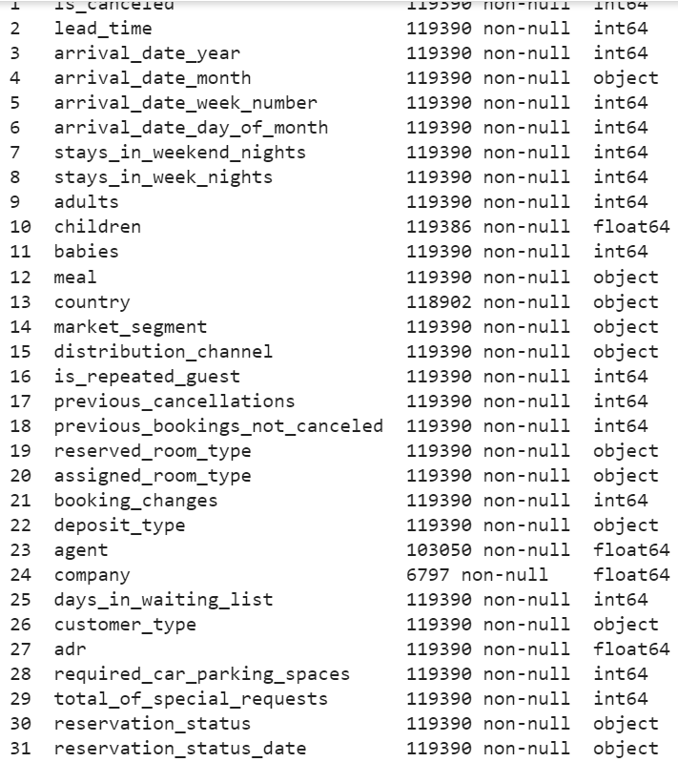

Data Wrangling
Shape of dataset
Data set information

Slide 8
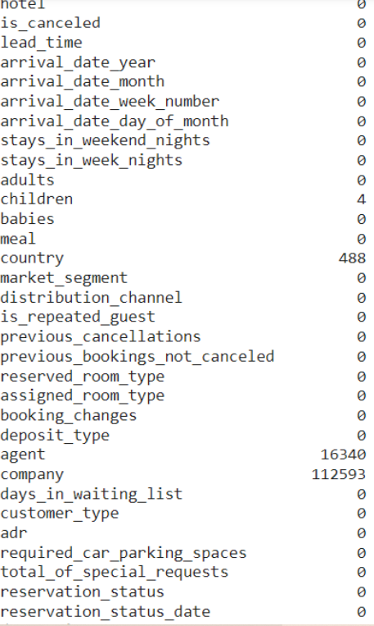
Data Wrangling
Finding the null value-

Slide 9
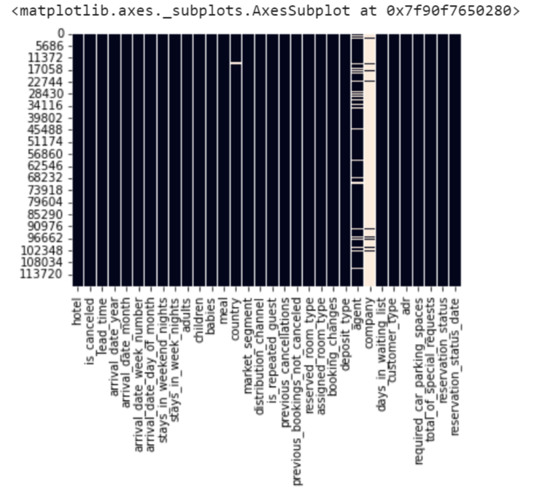
Null value visualization

Slide 10
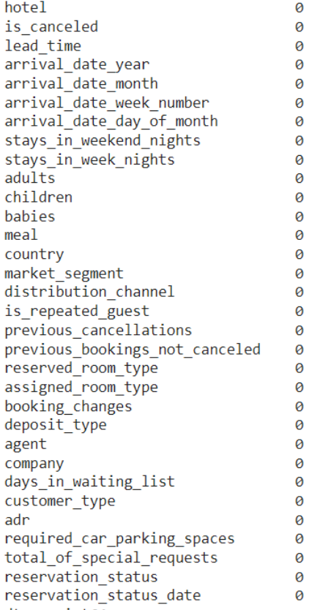

Replacing Null value

Slide 11
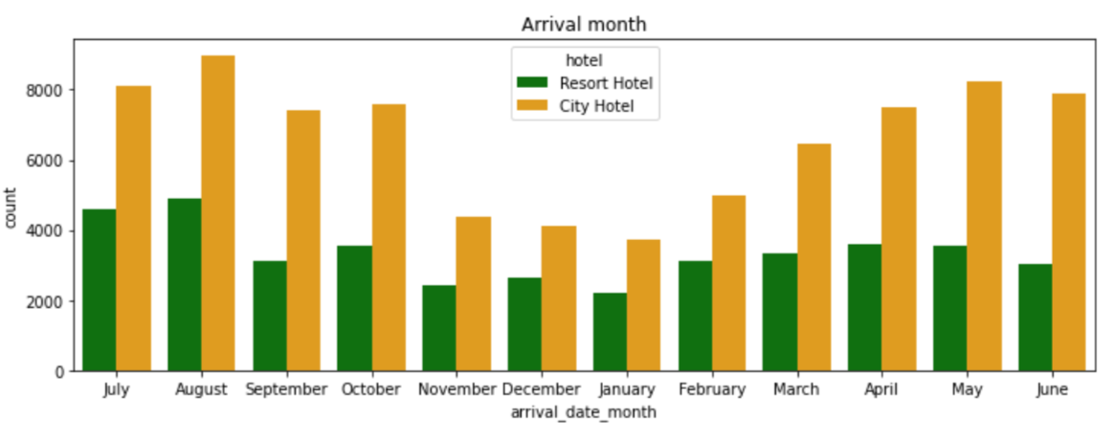
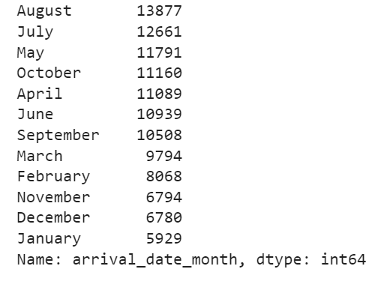
Exploratory data analysis
In which month the most number of guest arrivals?
so we are seeing August and July are the months with the highest number of guest for both hotels

Slide 12
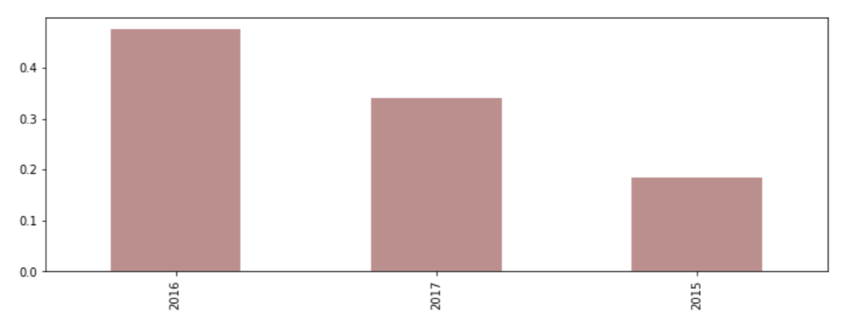
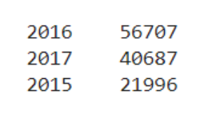
In which year the most number of guest arrived?
So the most number of guest arrived in 2016

Slide 13
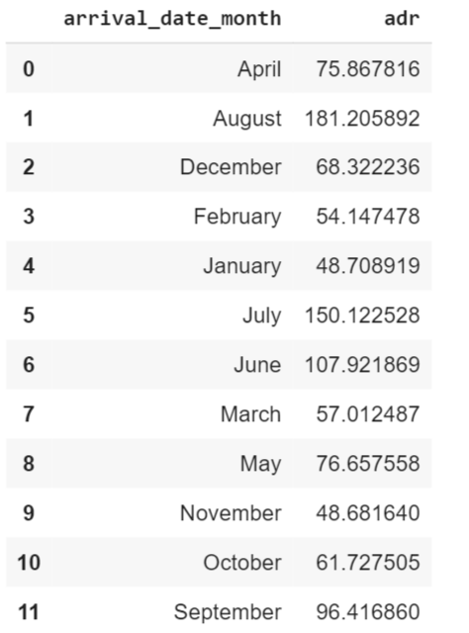
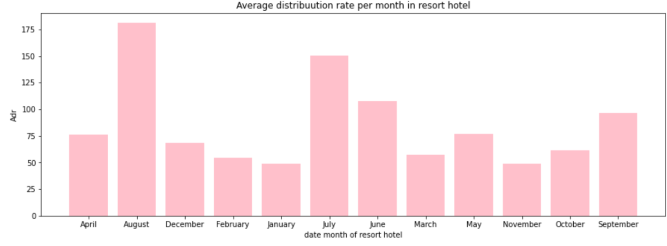
Finding out the varience in price per night in the hotels. Resort hotel analysis
So as wee see August is having a highest average distributed rate followed by July and June

Slide 14
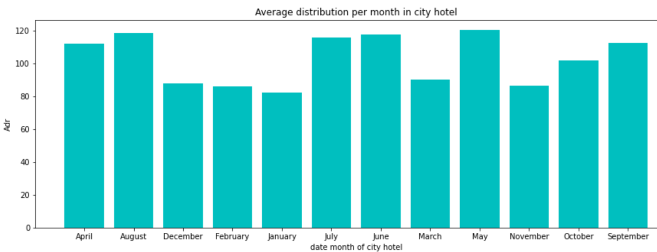
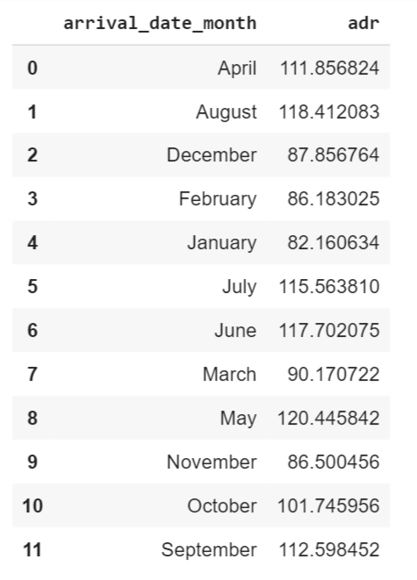
Analysis of City Hotel
So we see August is having a highest average distributed range followed by June and July

Slide 15
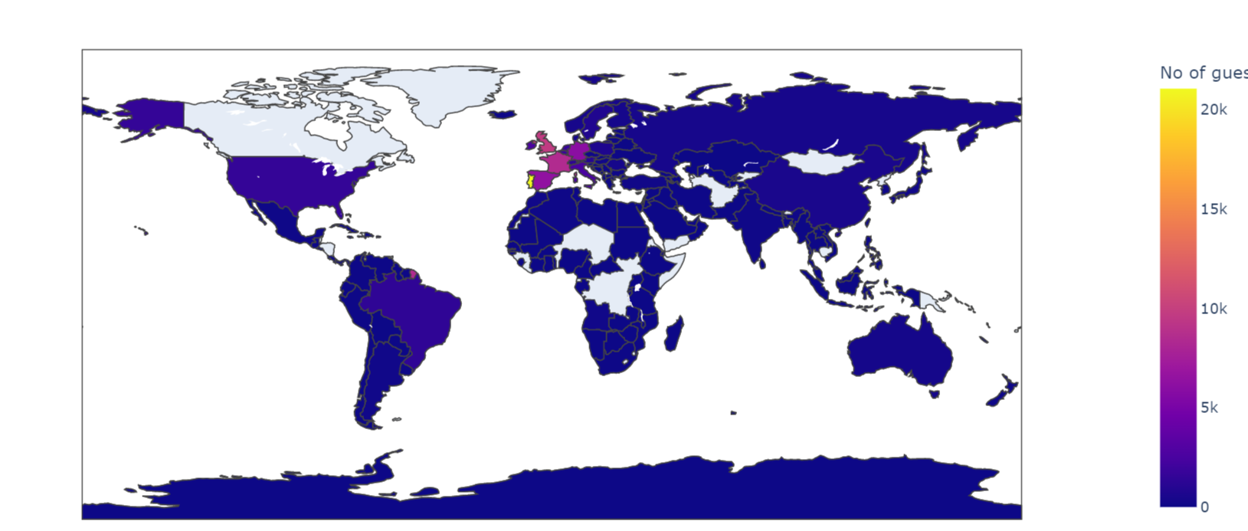
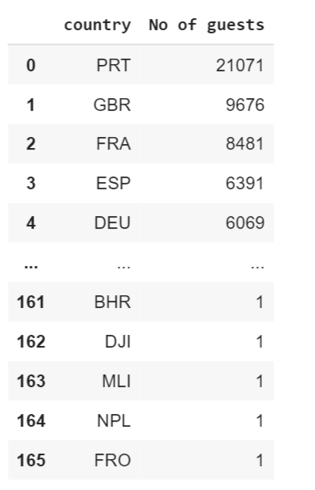
From which country customer are come from?
Most customers come from Europe, mainly from Portugal and neighboring

Slide 16
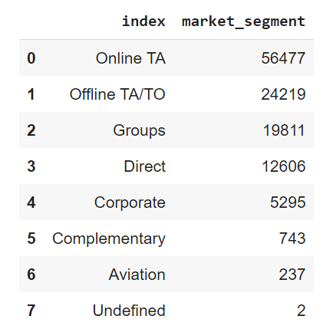
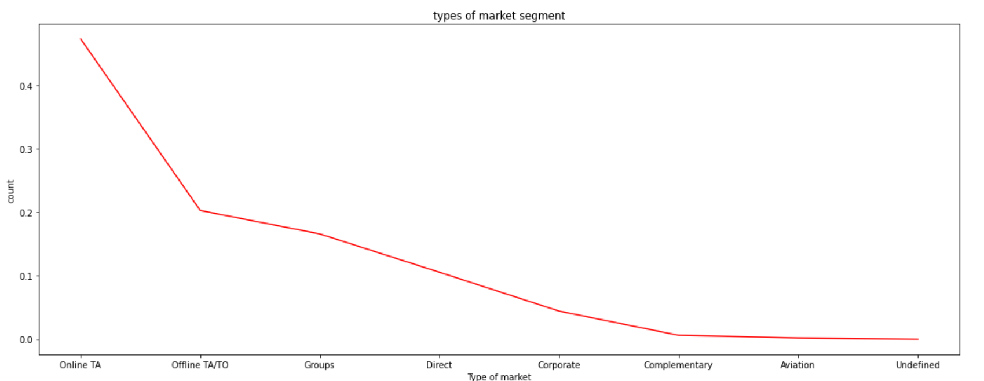
What is the strongest market segment and distribution channel?
So we see the most number of customer comes from Online TA

Slide 17
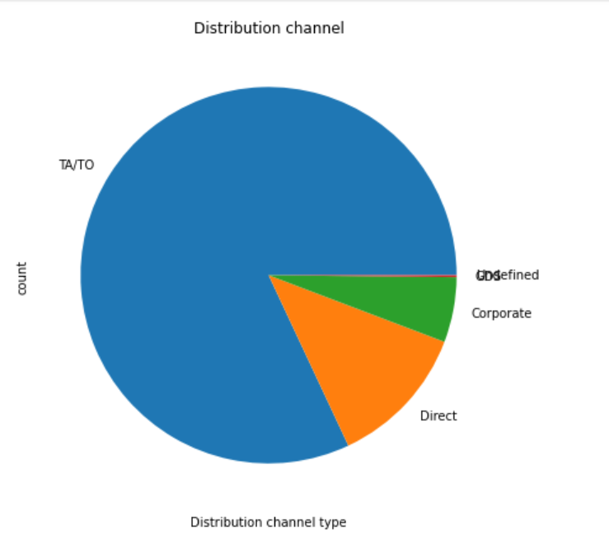
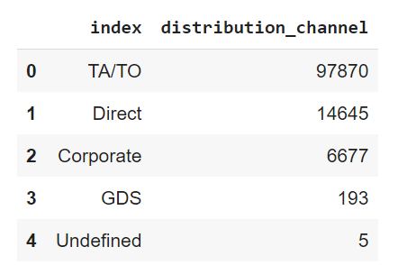
Travel agencies either online or offline are the majority distribution channels and market segment.

Slide 18
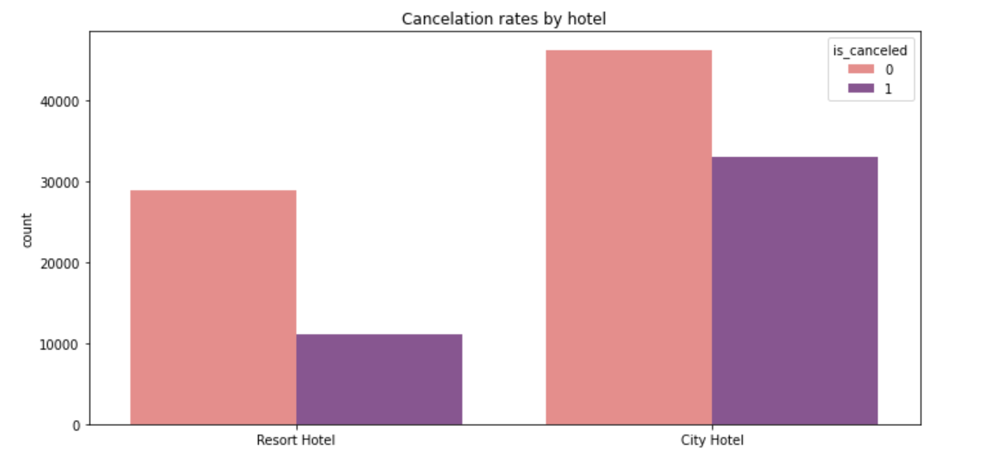
Checking the cancelled reservation?
As per graph we see that much of booking is not cancelled (0 represent not cancelled) and (1 represent the cancelled booking, so we see in the graph that city hotel booking are cancelled more than the resort hotel booking

Slide 19
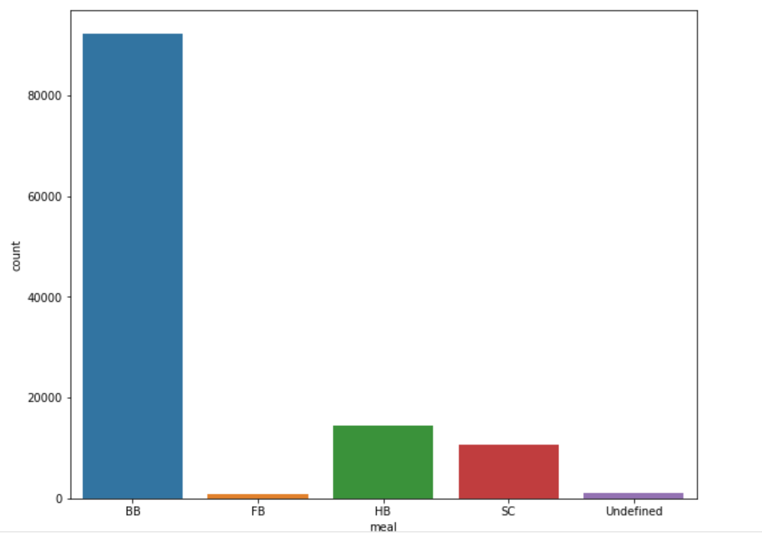
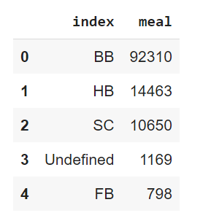
Checking the preferred meal by their customer
The preferred meal plan is bed and breakfast, as almost 92310 of bookings were made on this type of plan. half board (HB) and full board (FB) are less frequent options, but together they represent 25113 of reservations. It is important to note that practically no clients stayed with the self-catering option

Slide 20
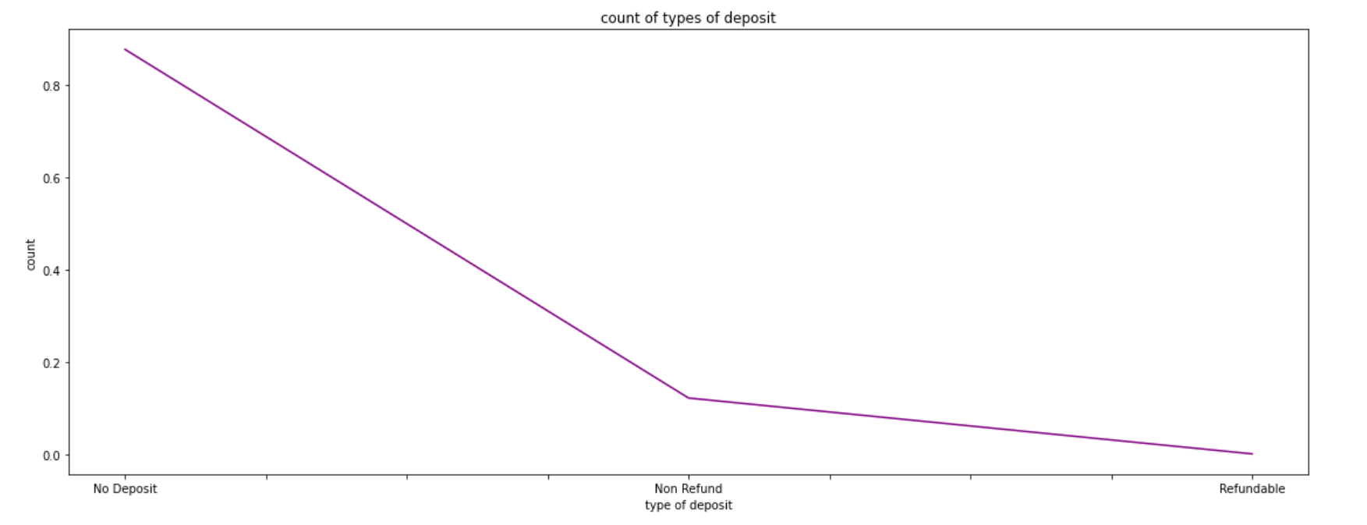
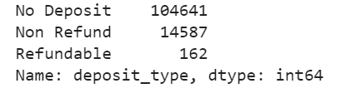
Checking the most frequent deposit type?
So in the graph we can see that the people are preferring the no deposit From the above data and graph it is clearly seen at more people are prefering the no deposit as compared to non refund and refundable.

Slide 21
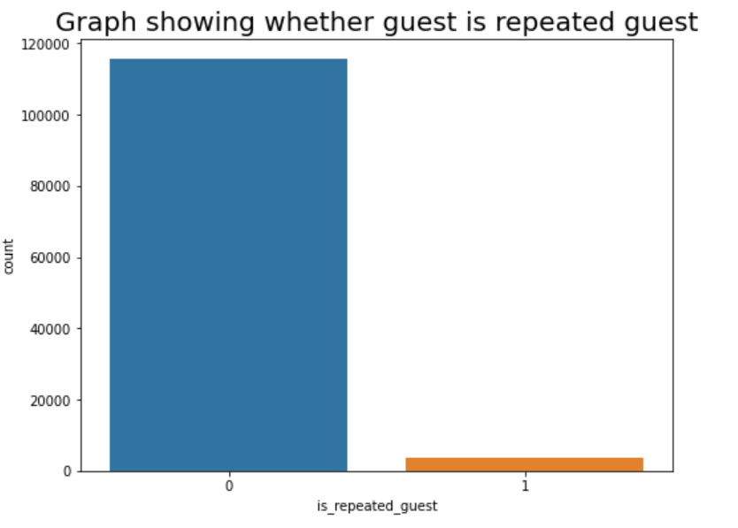
Checking the reservations made by repeated guests?
So we can see in the graph Low number of repeated guests. There is a need to target Repeated guests since they have booked before

Slide 22
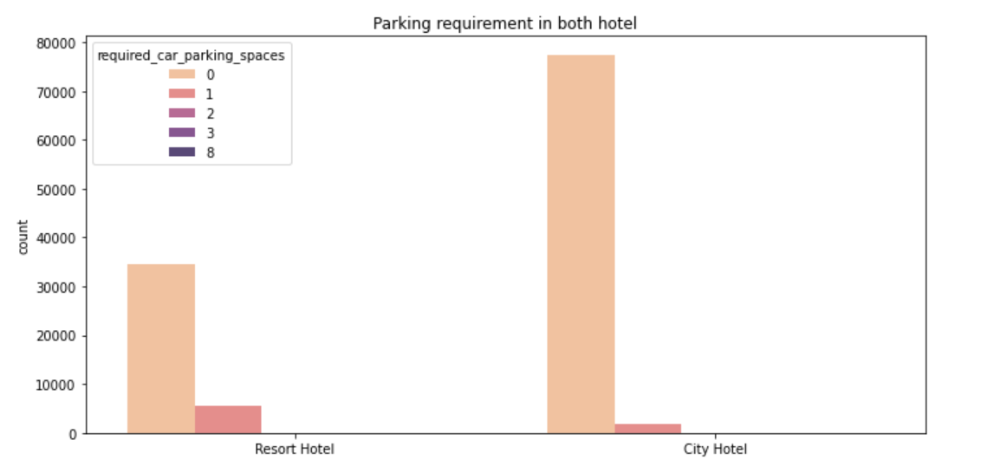
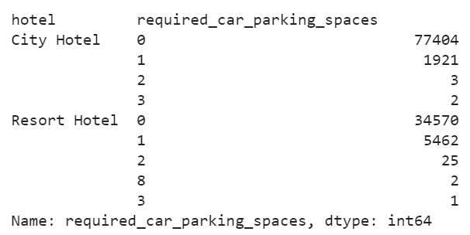
Lets see how many people require Parking space?
We can see that the maximum no of people not require parking and the people who require need 1 parking Very less people require more than 2 parking space.

Slide 23
Conclusion
The Majority number of the hotels booked are city hotel. Definitely need to spend the most targeting fund on those hotel.
We also realize that the high rate of cancellations can be due high no deposit policies.
We should also target month between June to Aug. Those are peak months due to the summer period and vacations
Majority of the guests are from Europe and Portugal .We should spend a significant amount of our budget on those area gain more customers.
Given that we do not have repeated guests, we should target on services and provide them good facilities guests to increase returning guests.
When it comes to identifying the most effective market segments and distribution channels, we have found that travel agents and tour operators have been the most successful, followed by direct bookings made through our hotel. To increase the use of this direct booking channel, we plan to offer special incentive for customers.

Slide 24
Thank You

